Slide 1
PYTHON
Lecture - 09
Lecture Topics
Reading and Writing Files
Exception Handling

Slide 2
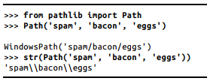
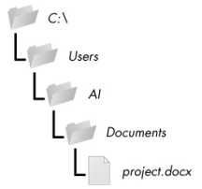
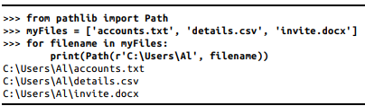
Files and File Paths
A file has two key properties: a filename (usually written as one word) and a path (C:\Users\Al\Documents)
Backslash on Windows and Forward Slash on macOS and Linux

Slide 3
The Current Working Directory
Current working directory: path.cwd()
Change directory: path.chdir()
>>> from pathlib import Path >>> import os >>> Path.cwd() WindowsPath('C:/Users/Al/AppData/Local/Programs/Python/Python37')' >>> os.chdir('C:\\Windows\\System32') >>> Path.cwd() WindowsPath('C:/Windows/System32')

Slide 4
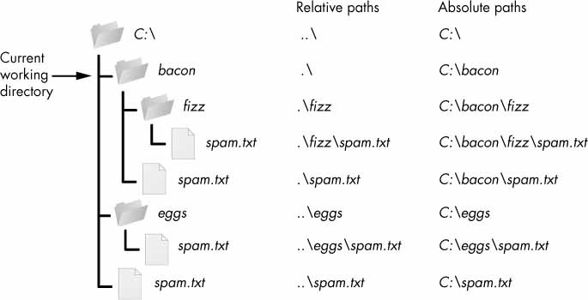
Absolute vs. Relative Paths

Slide 5
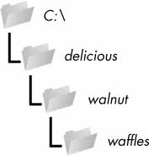
Creating New Folders Using the os.makedirs() Function
>>> import os >>> os.makedirs('C:\\delicious\\walnut\\waffles')

Slide 6
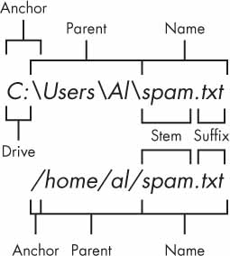
Getting the Parts of a File Path (1)
>>> p = Path('C:/Users/Al/spam.txt')
>>> p.anchor
'C:\\'
>>> p.parent # This is a Path object, not a string.
WindowsPath('C:/Users/Al')
>>> p.name
'spam.txt'
>>> p.stem
'spam'
>>> p.suffix
'.txt'
>>> p.drive
'C:'

Slide 7
Getting the Parts of a File Path (1)
The anchor, which is the root folder of the filesystem
On Windows, the drive, which is the single letter that often denotes a physical hard drive or other storage device
The parent, which is the folder that contains the file
The name of the file, made up of the stem (or base name) and the suffix (or extension)

Slide 8
Finding File Sizes and Folder Contents
Calling os.path.getsize(path) will return the size in bytes of the file in the path argument.
Calling os.listdir(path) will return a list of filename strings for each file in the path argument. (Note that this function is in the os module, not os.path)
>>> os.path.getsize('C:\\Windows\\System32\\calc.exe') 27648 >>> os.listdir('C:\\Windows\\System32') ['0409', '12520437.cpx', '12520850.cpx', '5U877.ax', 'aaclient.dll', --snip-- 'xwtpdui.dll', 'xwtpw32.dll', 'zh-CN', 'zh-HK', 'zh-TW', 'zipfldr.dll']

Slide 9
Checking Path Validity
Calling p.exists() returns True if the path exists or returns False if it doesn’t exist.
Calling p.is_file() returns True if the path exists and is a file, or returns False otherwise.
Calling p.is_dir() returns True if the path exists and is a directory, or returns False otherwise.
>>> winDir = Path('C:/Windows')
>>> notExistsDir = Path('C:/This/Folder/Does/Not/Exist')
>>> calcFile = Path('C:/Windows
/System32/calc.exe')
>>> winDir.exists()
True
>>> winDir.is_dir()
True
>>> notExistsDir.exists()
False
>>> calcFile.is_file()
True
>>> calcFile.is_dir()
False

Slide 10
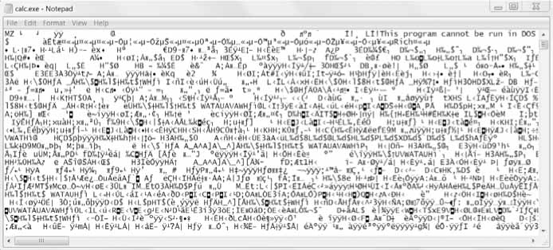
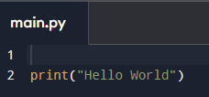
The File Reading/Writing Process
Plaintext files
Binary files

Slide 11
File Handling: Open
open() function takes two parameters; filename, and mode.
You can also specify the type of file
f = open("demofile.txt")
f = open("demofile.txt", "rt")
"r" - Read - Default value. Opens a file for reading, error if the file does not exist
"a" - Append - Opens a file for appending, creates the file if it does not exist
"w" - Write - Opens a file for writing, creates the file if it does not exist
"x" - Create - Creates the specified file, returns an error if the file exists
"t" - Text - Default value. Text mode
"b" - Binary - Binary mode (e.g. images)

Slide 12
Read and Close file
f = open("demofile.txt", "r") print(f.read())
f = open("D:\\myfiles\welcome.txt", "r") print(f.read())
f = open("demofile.txt", "r") print(f.read(5)) # Return the 5 first characters of the file
f = open("demofile.txt", "r") print(f.readline()) # Read one line of the file
f = open("demofile.txt", "r") for x in f: # Loop through the file line by line print(x)
f.close() # Close the file when you are finish with it

Slide 13
File Methods
Method | Description
close() | Closes the file
detach() | Returns the separated raw stream from the buffer
fileno() | Returns a number that represents the stream, from the operating system's perspective
flush() | Flushes the internal buffer
isatty() | Returns whether the file stream is interactive or not
read() | Returns the file content
readable() | Returns whether the file stream can be read or not
readline() | Returns one line from the file
readlines() | Returns a list of lines from the file
seek() | Change the file position
seekable() | Returns whether the file allows us to change the file position
tell() | Returns the current file position
truncate() | Resizes the file to a specified size
writable() | Returns whether the file can be written to or not
write() | Writes the specified string to the file
writelines() | Writes a list of strings to the file

Slide 14
Create/Write Files
Existing File
f = open("demofile2.txt", "a") # a = append, w = overwrite existing content f.write("Now the file has more content!") f.close()
New File
f = open("myfile.txt", "x")
"x" - Create - will create a file, returns an error if the file exist
"a" - Append - will create a file if the specified file does not exist
"w" - Write - will create a file if the specified file does not exist

Slide 15
Delete Files
Delete file
import os os.remove("demofile.txt") # if not exist produce an error
Check
import os if os.path.exists("demofile.txt"): os.remove("demofile.txt") else: print("The file does not exist")
Delete folder
import os os.rmdir("myfolder") # You can only remove empty folders

Slide 16
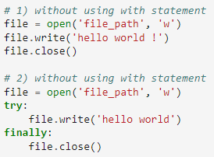


with statement in Python
Automatic resource management
Ensures that the file is automatically closed after operations are done, even if exceptions occur during file operations
you can use multiple contexts in a single with statement

Slide 17
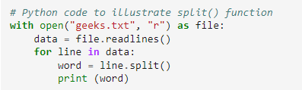
Read line by line
Split lines while reading files
The split () returns words in list format

Slide 18
File Name at Command Line Argument
import sys
import os
from os import path
if len(sys.argv) == 1:
sys.exit("Format: <python-command> <argu1>...<arguN>")
#initialize the fileNames
fileList = []
i = 1
while i < len(sys.argv):
if path.isfile(sys.argv[i]) is False:
sys.exit("File " + sys.argv[i] +" not exit")
else:
fileList.append (sys.argv[i])
i += 1
#count init
count = {}
# reading files and counting
for index in range(len(fileList)):
try:
file = open(fileList[index],"r")
….
Notes:
#===============================================================================
# FILE: Assignment
#
# USAGE: python asmt1.py argument1 argument2 ... argumentN
# EXAMPLE: python asmt1.py Sample_File_1.txt Sample_File_2.txt Sample_File_3.txt
# python asmt1.py /home/asif/Desktop/Sample_File_1.txt /home/asif/Desktop/Sample_File_2.txt
# TESTED: Ubuntu 18.04 LTS AND Python version: 3.7.3
#
# DESCRIPTION:
# AUTHOR: Md. Rashid Al Asif, dev.rashid.asif@gmail.com
#===============================================================================
import sys
import time
import string
import os
from os import path
if __name__ == '__main__':
# get the start time
start_time = time.time()
if len(sys.argv) == 1:
sys.exit("Format: <python-command> <argu1>...<arguN>")
#initialize the fileNames
fileList = []
i = 1
while i < len(sys.argv):
if path.isfile(sys.argv[i]) is False:
sys.exit("File " + sys.argv[i] +" not exit")
else:
fileList.append (sys.argv[i])
i += 1
#count init
count = {}
# reading files and counting
for index in range(len(fileList)):
try:
file = open(fileList[index],"r")
while True:
# Get next line from file
line = file.readline()
if not line:
break
# Remove the leading spaces and newline character
line = line.strip()
# line =line.replace("\n", "")
# Remove the punctuation marks (!"#$%&'()*+, -./:;<=>?@[\]^_`{|}~) from the line
#line = line.translate(line.maketrans("", "", string.punctuation))
words = line.split()
for word in words:
if word in count:
count[word] = count[word] + 1
else:
count[word] = 1
except IOError:
print("IO Error Occured")
#print the starting time
print("\nStarting Time: ", time.asctime(time.localtime(start_time)), "\n")
#printing the count
print(count)
#get the end time and print the duration
end_time = time.time()
print("\nEnding Time: ", time.asctime(time.localtime(end_time)), "\n")
print("\nDuration: %s seconds " % (end_time - start_time), "\n")

Slide 19

Exercise Time

Slide 20
Problems
Find all prime numbers from input file (number.txt) which contains values as follows:
2
13
12
Find all vowel from a string.txt file.

Slide 21
Exception Handling/Managing Exception
When an error occurs, or exception as we call it, Python will normally stop and generate an error message
try: print(x) except: print("An exception occurred")
The try block lets you test a block of code for errors.
The except block lets you handle the error.
The else block lets you execute code when there is no error.
The finally block lets you execute code, regardless of the result of the try- and except blocks.

Slide 22
Many Exceptions
try: print(x) except NameError: print("Variable x is not defined") except: print("Something else went wrong")

Slide 23
Else
The try block does not raise any errors, so the else block is executed:
try: print("Hello") except: print("Something went wrong") else: print("Nothing went wrong")

Slide 24
Finally
The finally block, if specified, will be executed regardless if the try block raises an error or not.
try: print(x) except: print("Something went wrong") finally: print("The 'try except' is finished")
can be useful to close objects and clean up resources.
file = ('file_path', 'w’)
try:
file.write('hello world’)
finally:
file.close()

Slide 25
Raise an exception
x = -1 if x < 0: raise Exception("Sorry, no numbers below zero")
x = "hello" if not type(x) is int: raise TypeError("Only integers are allowed")

Slide 26
Different Types of Exception
SyntaxError: This exception is raised when the interpreter encounters a syntax error in the code, such as a misspelled keyword, a missing colon, or an unbalanced parenthesis.
TypeError: This exception is raised when an operation or function is applied to an object of the wrong type, such as adding a string to an integer.
NameError: This exception is raised when a variable or function name is not found in the current scope.
IndexError: This exception is raised when an index is out of range for a list, tuple, or other sequence types.
KeyError: This exception is raised when a key is not found in a dictionary.
ValueError: This exception is raised when a function or method is called with an invalid argument or input, such as trying to convert a string to an integer when the string does not represent a valid integer.
AttributeError: This exception is raised when an attribute or method is not found on an object, such as trying to access a non-existent attribute of a class instance.
IOError: This exception is raised when an I/O operation, such as reading or writing a file, fails due to an input/output error.
ZeroDivisionError: This exception is raised when an attempt is made to divide a number by zero.
ImportError: This exception is raised when an import statement fails to find or load a module.

Slide 27

Thank You

Slide 28
Resources
https://www.geeksforgeeks.org/file-handling-python/
https://www.geeksforgeeks.org/with-statement-in-python/
https://www.tutorialspoint.com/what-is-the-use-of-the-with-statement-in-python
https://www.w3schools.com/python/python_try_except.asp
Head First Python, 3rd Edition by Paul Barry
Automate the Boring Stuff with Python By Al Sweigart.

